Slide 1
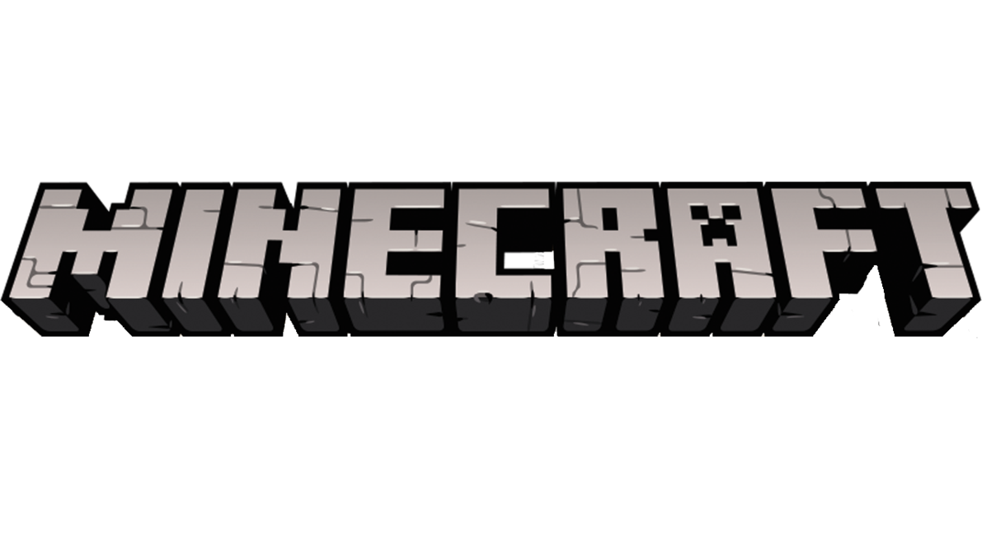
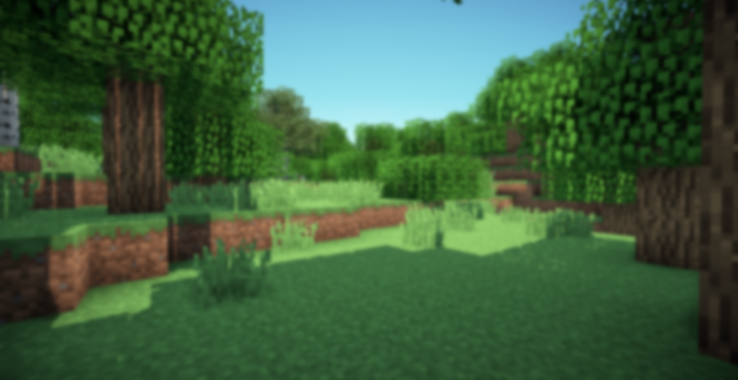
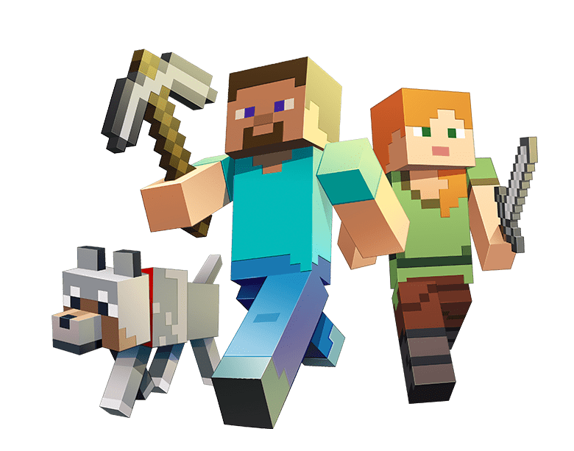
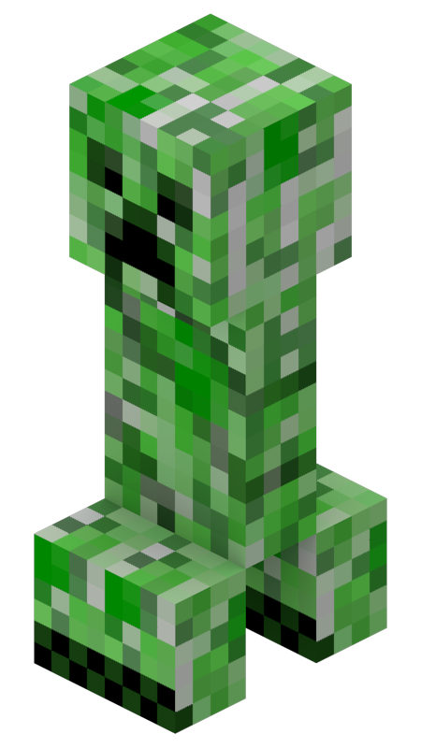
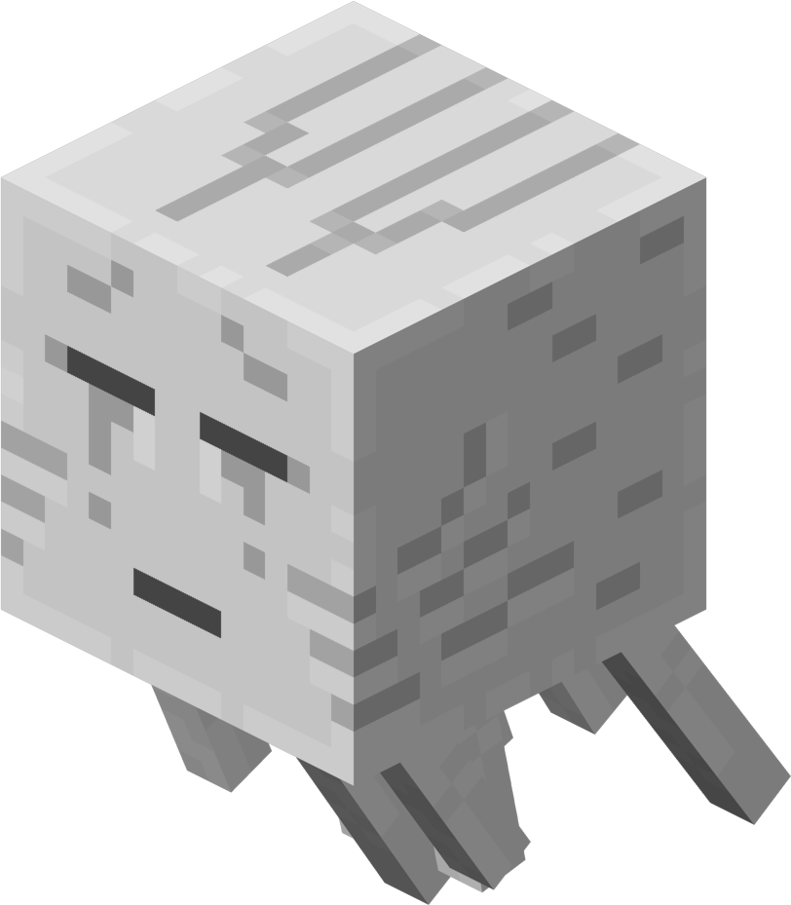
What do players do in the game?
What do players do in the game?
Start the Game
Options.
Quit
Jiamin Chen
Tracy Li
Winter 2025

Slide 2
Loading……

Slide 3
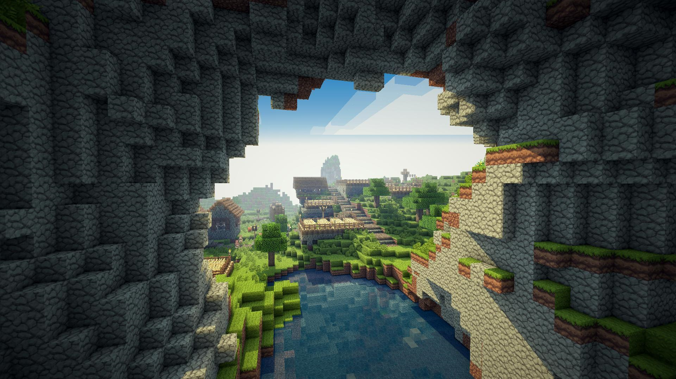
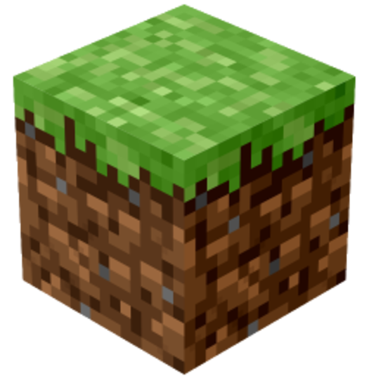
WELCOME
Minecraft is a sandbox video game.
Players can interact with a fully customizable three-dimensional world made of blocks and entities
Diverse gameplay options：survival, creative, adventure, hardcore, spectator

Slide 4

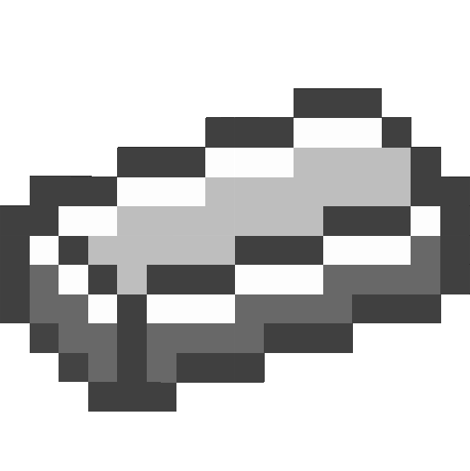
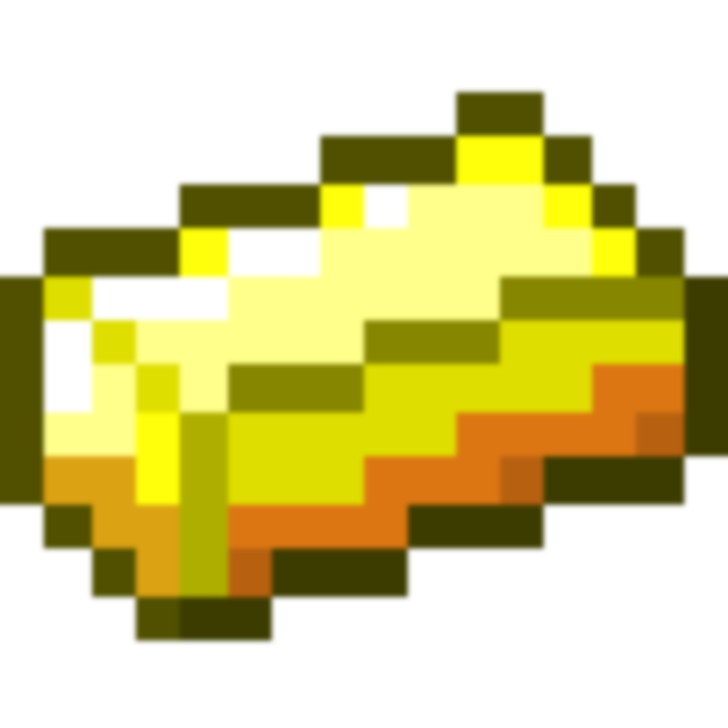
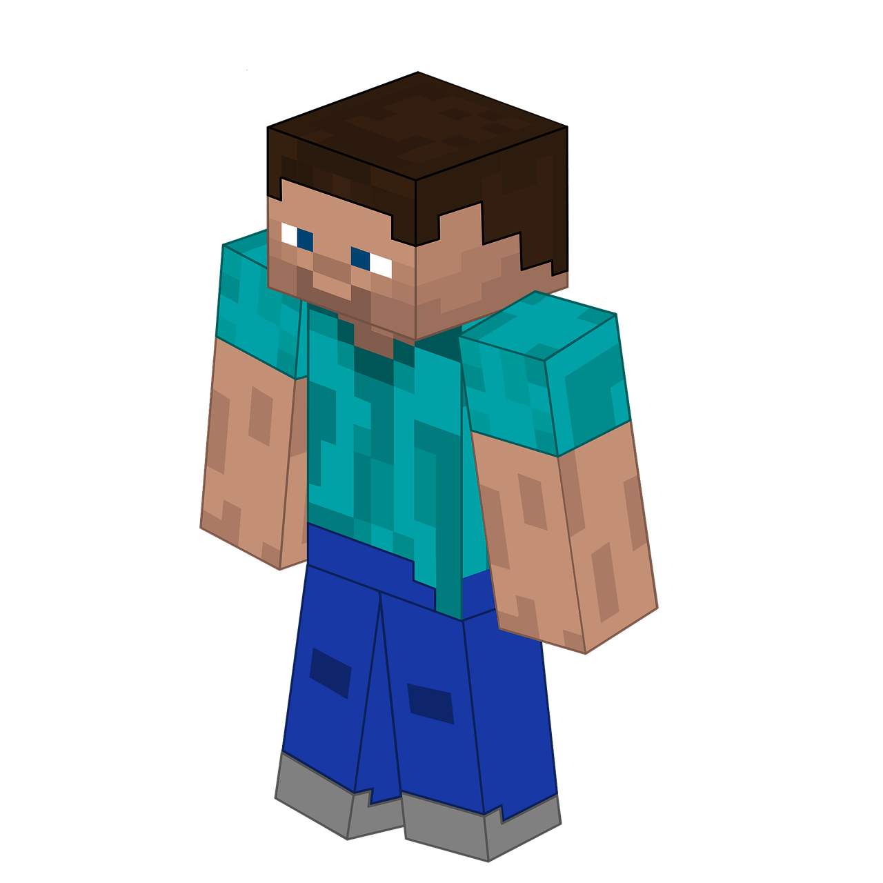
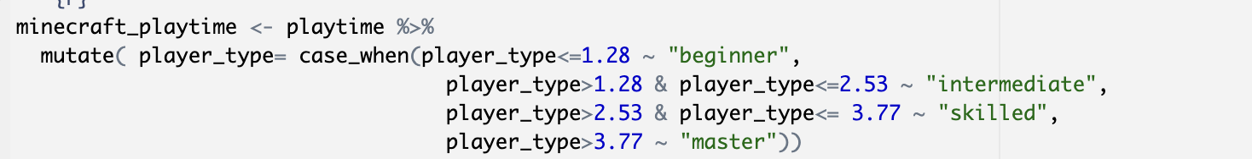
Data and Cleaning
Data from:
kaggle “Minecraft Gaming User Data”
https://www.kaggle.com/datasets/manandkumar/minecraft-gaming-user-data
15,000 rows and 25 columns
Cleaning:
Filter out survival players in PC
Categorize players in four groups by their play time
Final data: 1,241 entries, 26 total columns

Slide 5
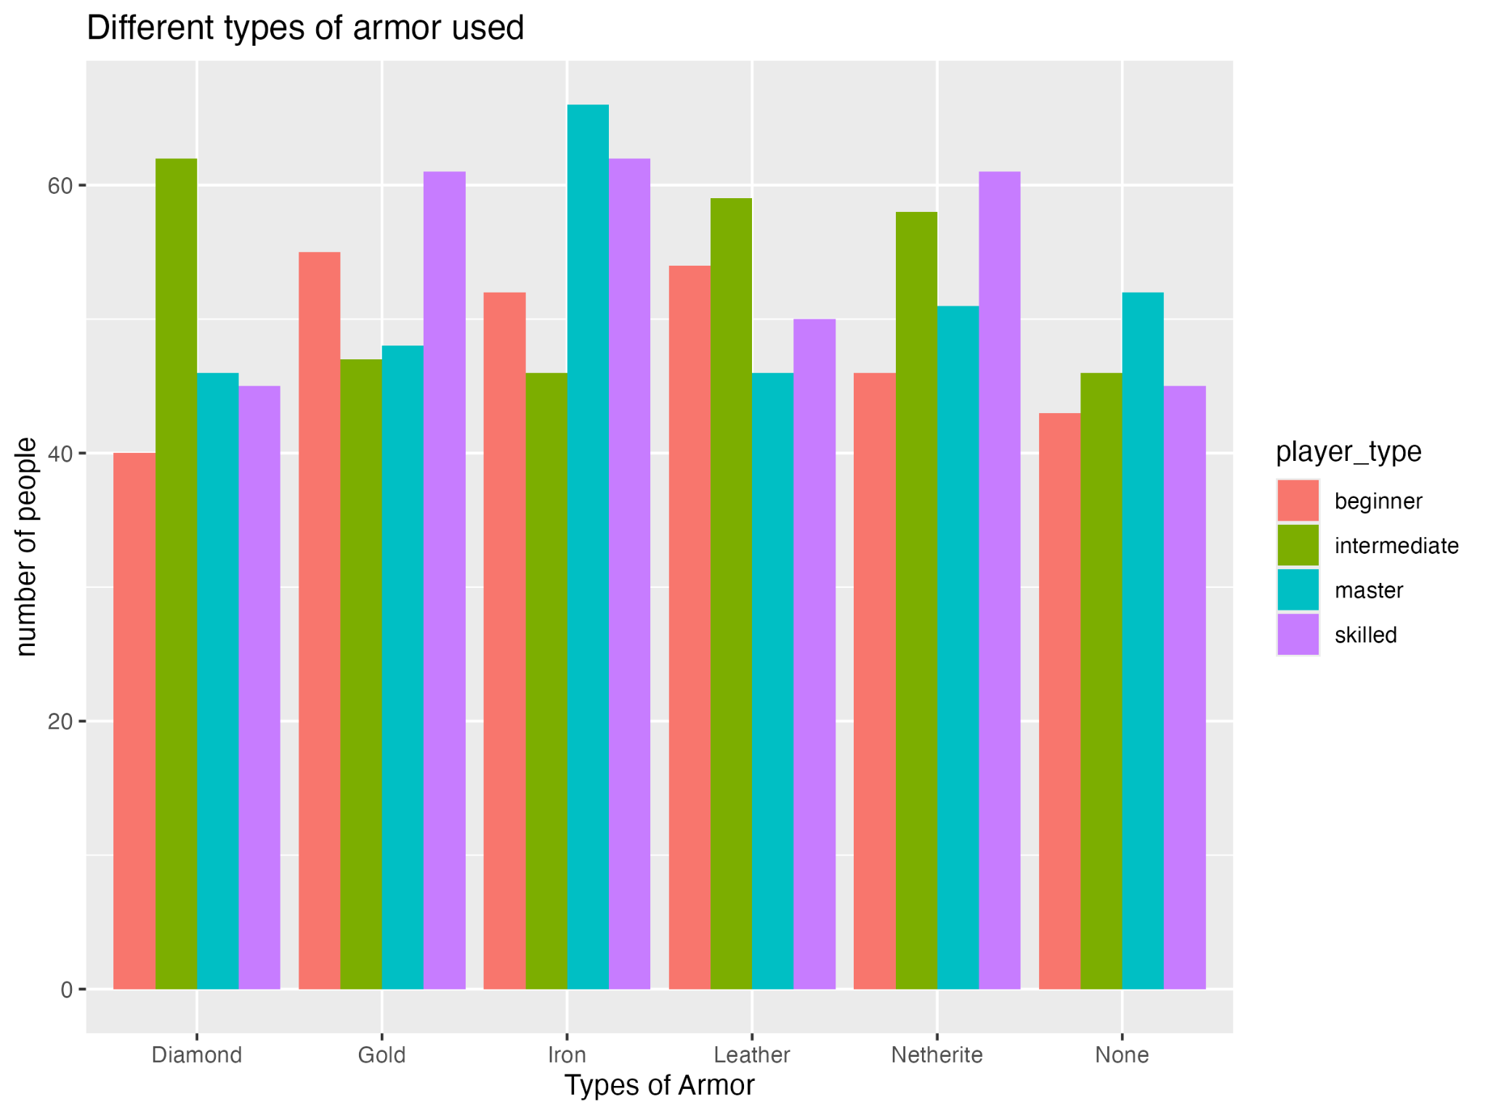
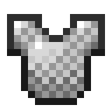

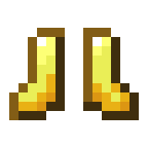

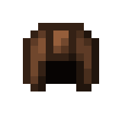
Result
Armor
Tools
Biomes
Blocks
master and skilled player prefer iron armor
while beginners prefer golden armor

Slide 6
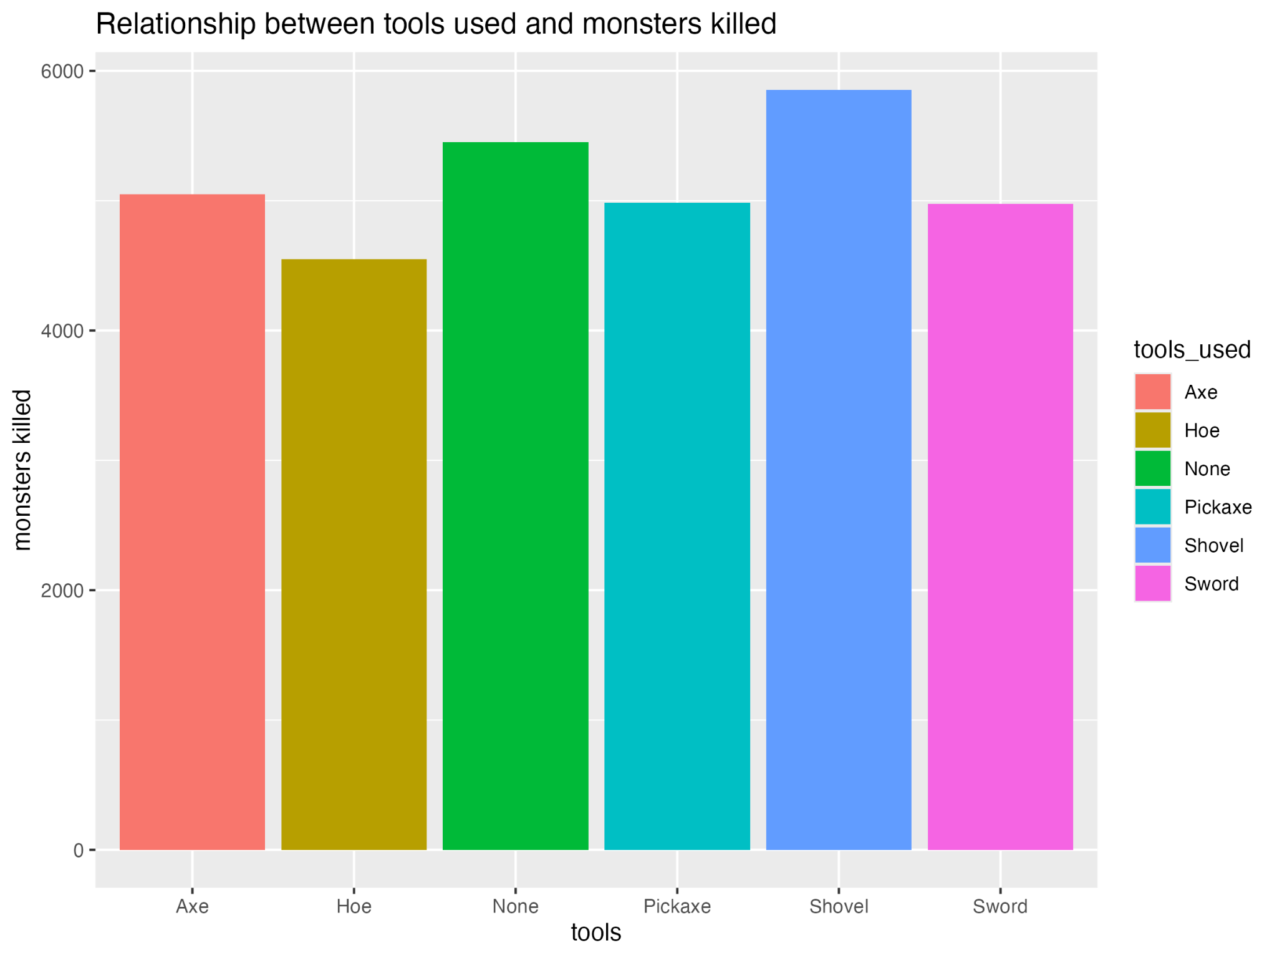
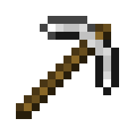
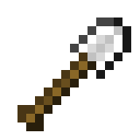
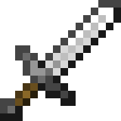
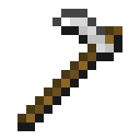
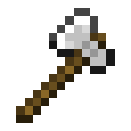
Result
Armor
Tools
Biomes
Blocks
players using shovels kill most of monsters (surprising)
players using hoes kill least

Slide 7
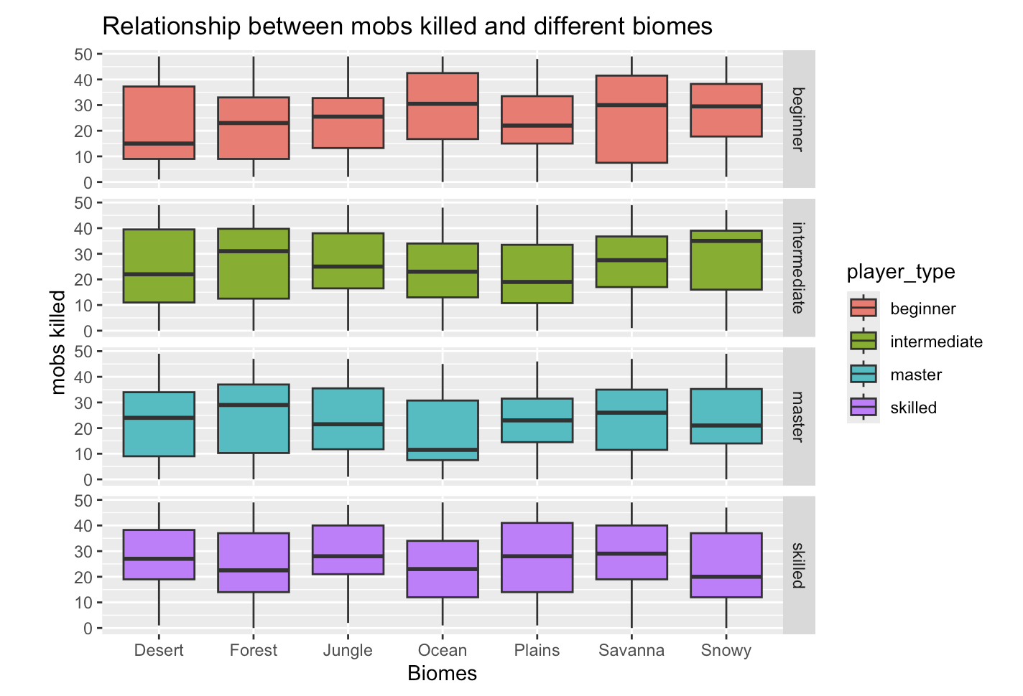
Result
Armor
Tools
Biomes
Blocks
overall, the number of mobs killed are higher in those biomes with more diversable mobs (forest, jungle, plains)

Slide 8
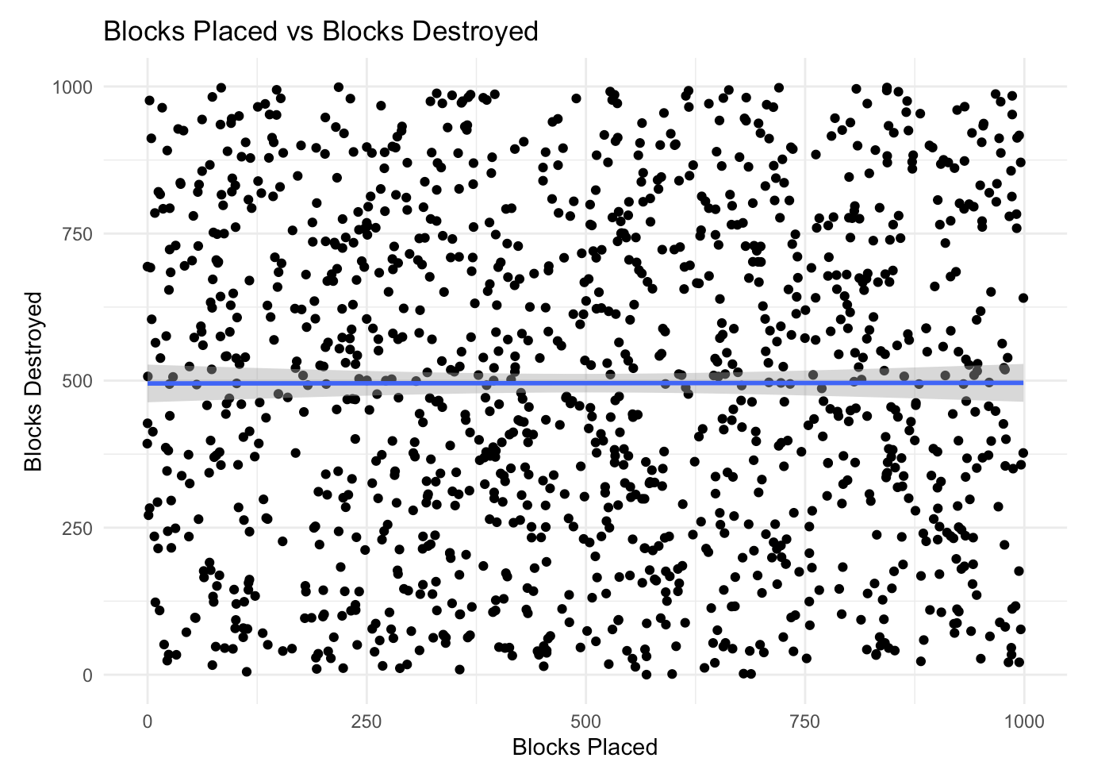
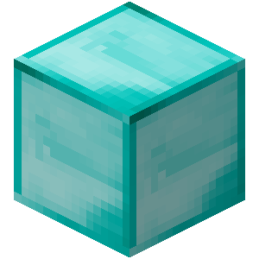
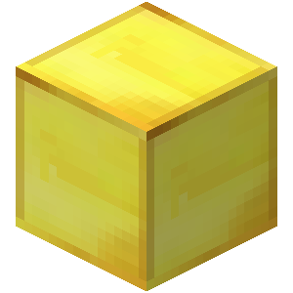
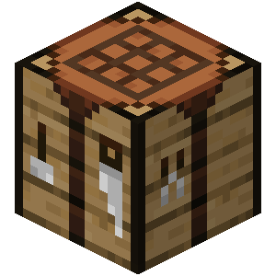
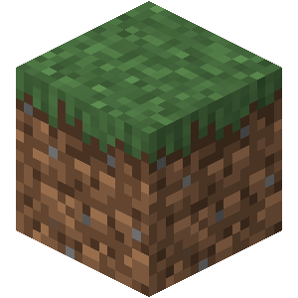
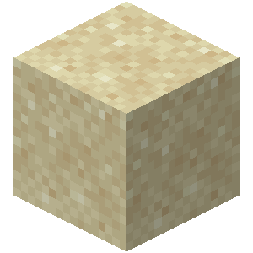
Result
Armor
Tools
Biomes
Blocks
Sustainable gaming?
No correlation between blocks Place & destroy

Slide 9
THANK
YOU
Quit
Restart
Stay green & play games

